Slide 1
WELCOME TO THE NEIGHBORHOOD

Slide 2
Suddenly, the person I claimed as a best
friend became my biggest enemy.

Slide 3
We dehumanize our neighbor to make them
our nemesis.

Slide 4
COMPARISON

Slide 5
COMPARISON
HATRED

Slide 6
COMPARISON
HATRED
GOSSIP

Slide 7
COMPARISON
HATRED
GOSSIP
SLANDER

Slide 8
COMPARISON
HATRED
GOSSIP
SLANDER
PAIN

Slide 9
COMPARISON
HATRED
GOSSIP
SLANDER
PAIN
DEATH

Slide 10
COMPARISON
HATRED
GOSSIP
SLANDER
PAIN
DEATH
LONELINESS

Slide 11
COMPARISON
HATRED
GOSSIP
SLANDER
PAIN
DEATH
LONELINESS
DEPRESSION

Slide 12
COMPARISON
HATRED
GOSSIP
SLANDER
PAIN
DEATH
LONELINESS
DEPRESSION
ANXIETY

Slide 13
COMPARISON
HATRED
GOSSIP
SLANDER
PAIN
DEATH
LONELINESS
DEPRESSION
ANXIETY
ABANDONMENT

Slide 14
COMPARISON
HATRED
GOSSIP
SLANDER
PAIN
DEATH
LONELINESS
DEPRESSION
ANXIETY
ABANDONMENT
CONFUSION

Slide 15
Now Adam had sexual relations with his wife, Eve, and she became pregnant. When she gave birth to Cain, she said, “With
the Lord’s help, I have produced a man!”
Later she gave birth to his brother and named him Abel.
GENESIS 4:1-2, NLT

Slide 16
GENESIS 4:2-4, NLT
When they grew up, Abel became a shepherd,
while Cain cultivated the ground. When it
was time for the harvest, Cain presented
some of his crops as a gift to the Lord.
Abel also brought a gift—the best portions
of the firstborn lambs from his flock.

Slide 17
GENESIS 4:4-5, NLT
The Lord accepted Abel and his gift, but
he did not accept Cain and his gift. This
made Cain very angry, and he looked
dejected.

Slide 18
Perhaps your narrative of your neighbor
was crafted in the dark—that’s why you
can’t see the light.

Slide 19
GENESIS 4:6, NLT
“Why are you so angry?” the Lord asked
Cain. “Why do you look so dejected?

Slide 20
GENESIS 4:7, NLT
“You will be accepted if you do what is
right. But if you refuse to do what is
right, then watch out! Sin is crouching at
the door, eager to control you. But you
must subdue it and be its master.”

Slide 21
GENESIS 4:8, NLT
One day Cain suggested to his brother,
“Let’s go out into the fields.” And while they were in the field, Cain
attacked his brother, Abel, and killed
him.

Slide 22
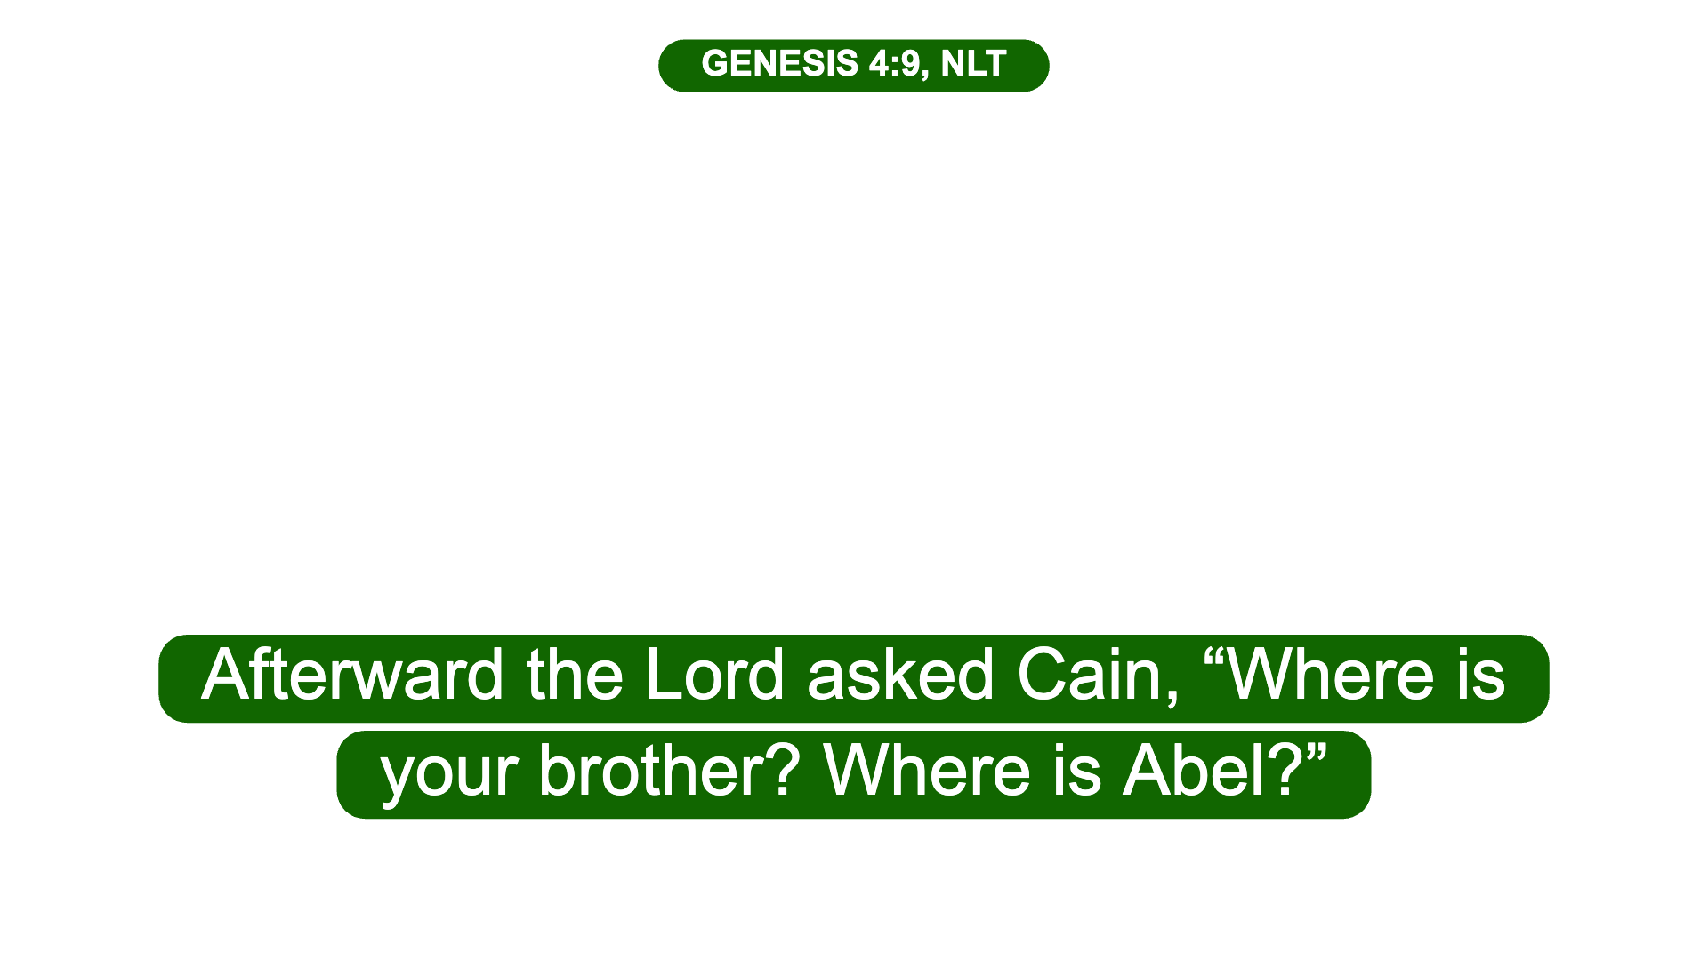

Slide 23
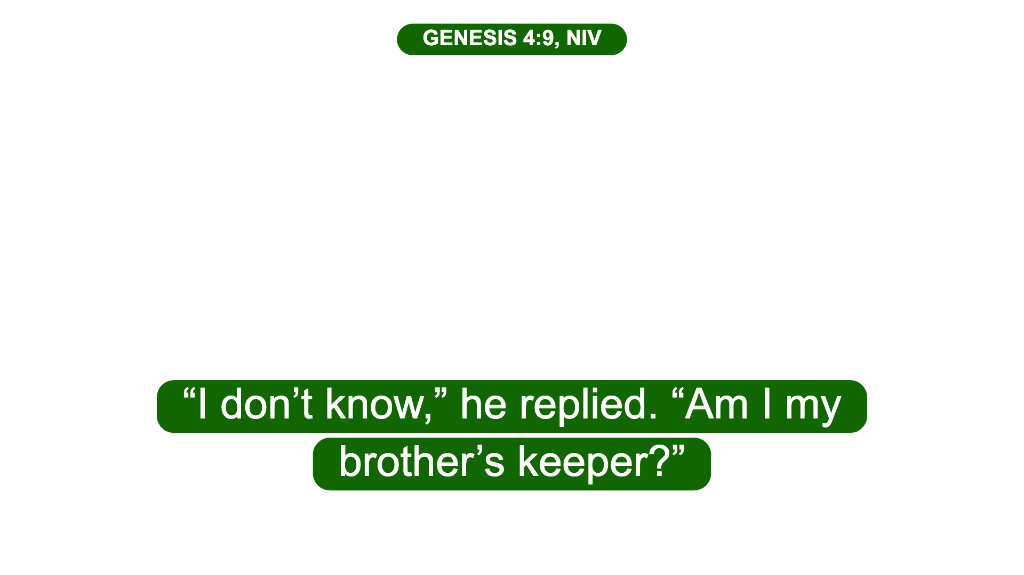

Slide 24
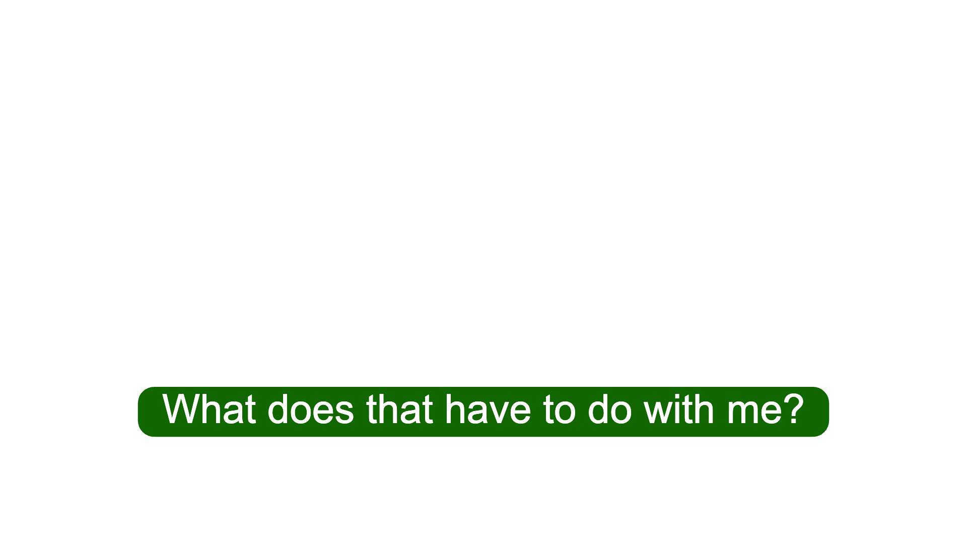

Slide 25
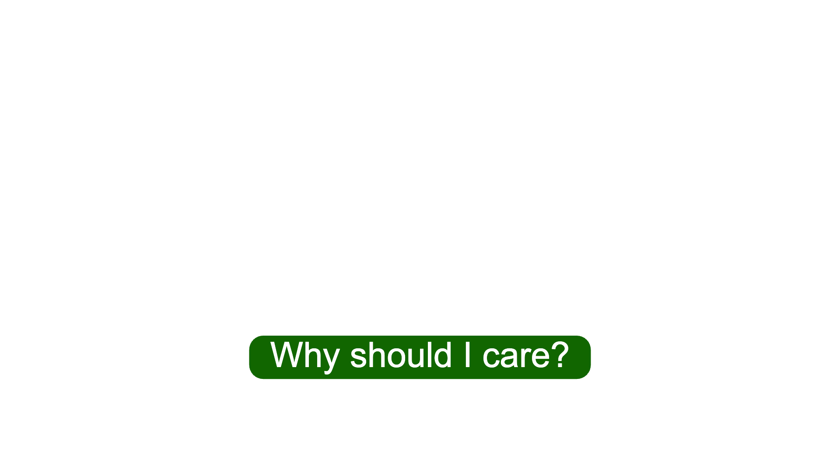

Slide 26
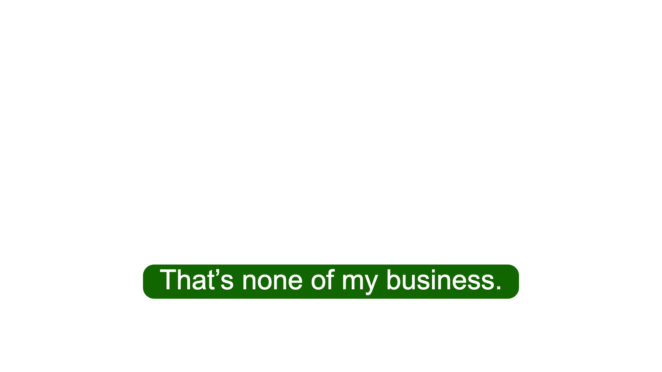

Slide 27
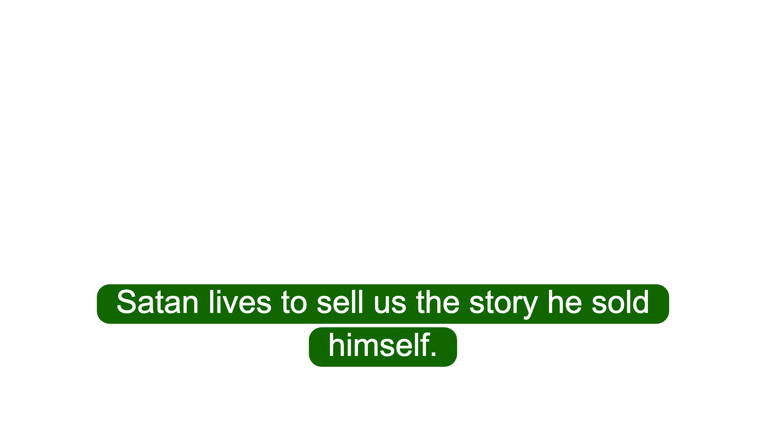

Slide 28
ISAIAH 25:6, NLT
In Jerusalem, the Lord of Heaven’s Armies
will spread a wonderful feast for all the
people of the world. It will be a
delicious banquet with clear, well-aged
wine and choice meat.

Slide 29
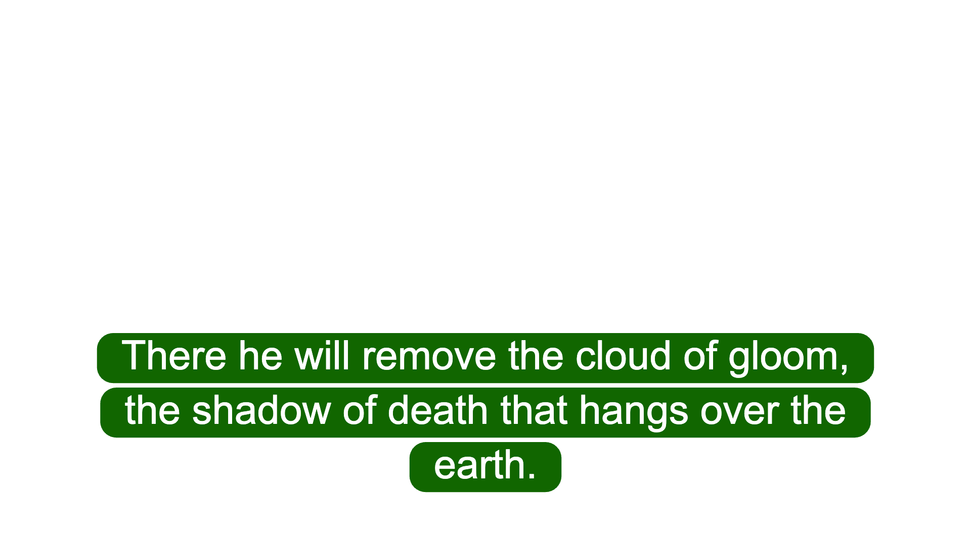

Slide 30
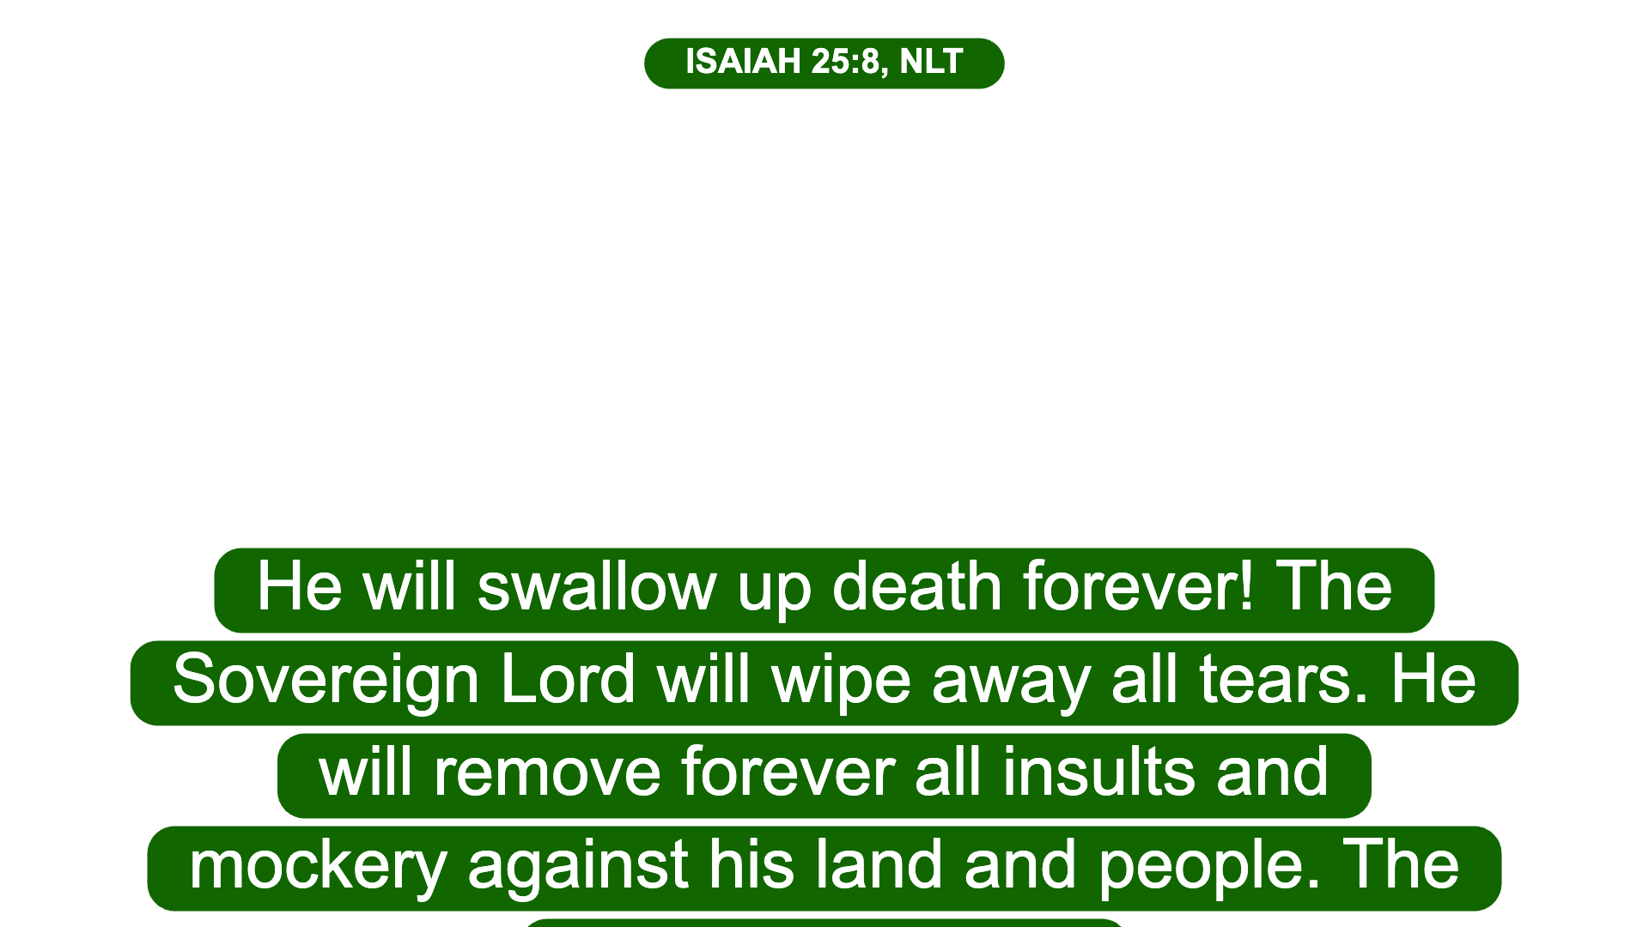

Slide 31
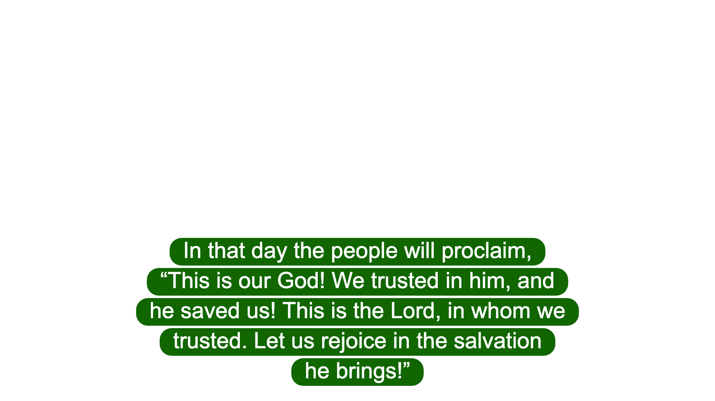

Slide 32
